Slide 1
netVLAD
2022.09.29
강경수

Slide 2
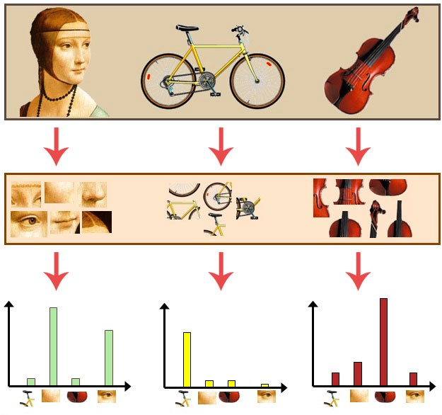
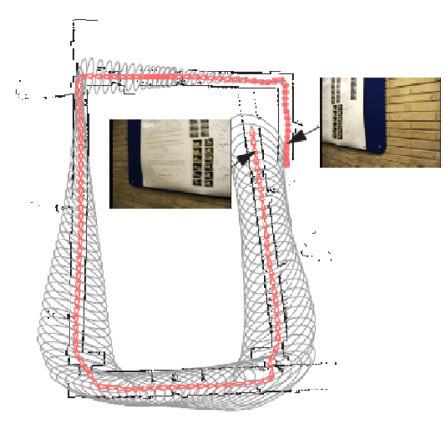
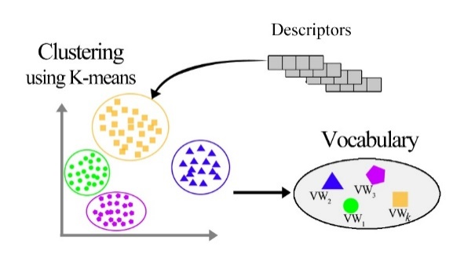
Topic – global place recognition
2 /
- BoW
Using SIFT feature
How to use and training CNN feature in BoW(or other) ?

Slide 3
Motivation & contribute
3 /
- netvlad
end-to-end deep learning using VLAD
for place recognition
Contribution (1). Combine Traditional and deep method
- change from SIFT to CNN and made by end-to-end learning

Slide 4
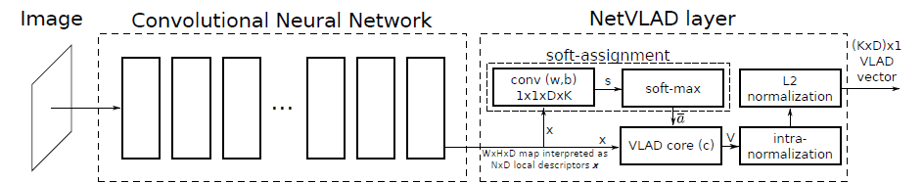
netVLAD
4 /
- overview
ResNet,
VGG-16,
Pretraining CNN architecture
Make VLAD Vector
(pooling)

Slide 5

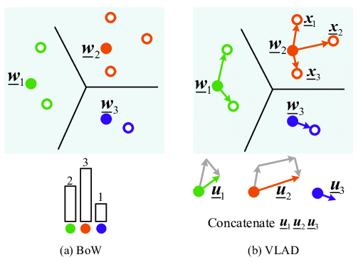
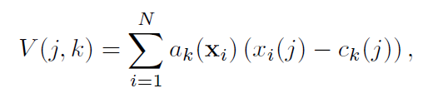
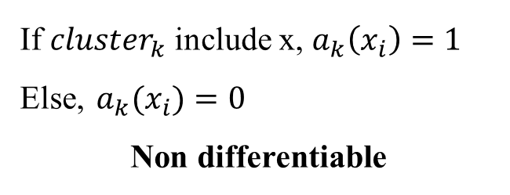
netVLAD
5 /
- VLAD
BoW →
K-mean cluster & histogramming
VLAD →
K-mean cluster & sum vector
If ${cluster}_{k}$ include x, $a_{k}\left(x_{i}\right)=1$
Else, $a_{k}(x_{i})=0$
Non differentiable

Slide 6
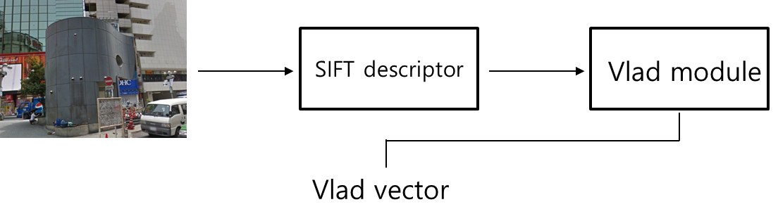
netVLAD
6 /
- VLAD to netVLAD

Slide 7
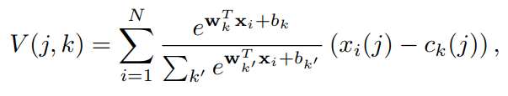

netVLAD
7 /
- netVLAD
For learing, $a_{k}$ must can be differentiable

Slide 8
netVLAD
8 /
- netVLAD
For learing, $a_{k}$ must can be differentiable
Probability of inclusion in a cluster

Slide 9
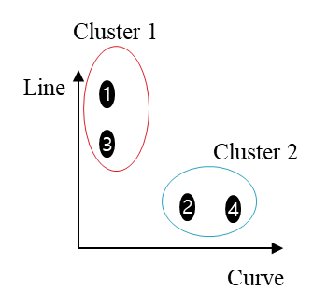
netVLAD
9 /
- netVLAD
Distance of cluster center and feature
* Probability of inclusion in a cluster

Slide 10
netVLAD
10 /
- netVLAD
Curve
Line
CNN
1
2
3
4
Cluster 1
Cluster 1
Cluster 2
Line
Sum line
distance
1
3
Cluster 2
2
4
Sum curve
distance
Curve
K(cluster num) * D(depth or channel num) dimension vector

Slide 11
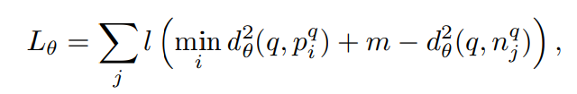
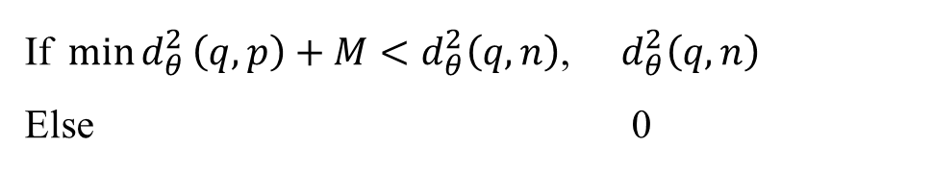
netVLAD
11 /
- learning
Closest image in positive
Negative image
If$\min{d_{θ}^{2}}\left(q,p\right)+M<d_{θ}^{2}\left(q,n\right)$, $d_{θ}^{2}\left(q,n\right)$
Else 0
netVLAD module finded vlad vector
for finding Closest image,
Lose = 0

Slide 12
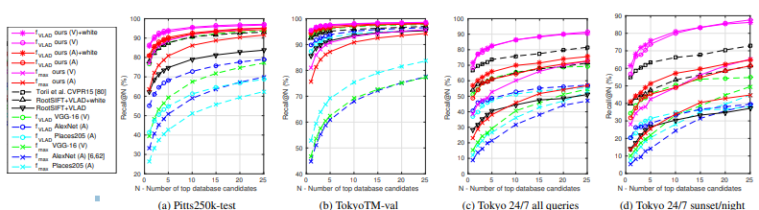
netVLAD
12 /
- Experiments

Slide 13
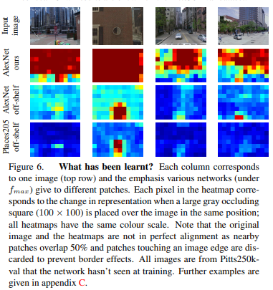
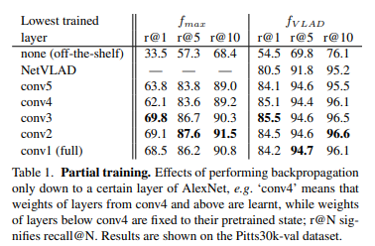
netVLAD
13 /
- Experiments

Slide 14
netVLAD
14 /
- limitation
So, exactly where?
netVLAD only know similarity
Patch – netVLAD
Patch-NetVLAD: Multi-Scale Fusion of Locally-Global Descriptors for Place Recognition

Slide 15
Q & A.
15 /

